Slide 1


Third Generation Intelligent Car Team: Straight Outta CompE
Presenters:
Zachary Rauen
Juan Merchan
Jayesh Bokhiria

Slide 2
Overview
Overall Design
Design Decomposition
Specific Achievements
Unique Innovations
Weakness
Technology Assessment

Slide 3
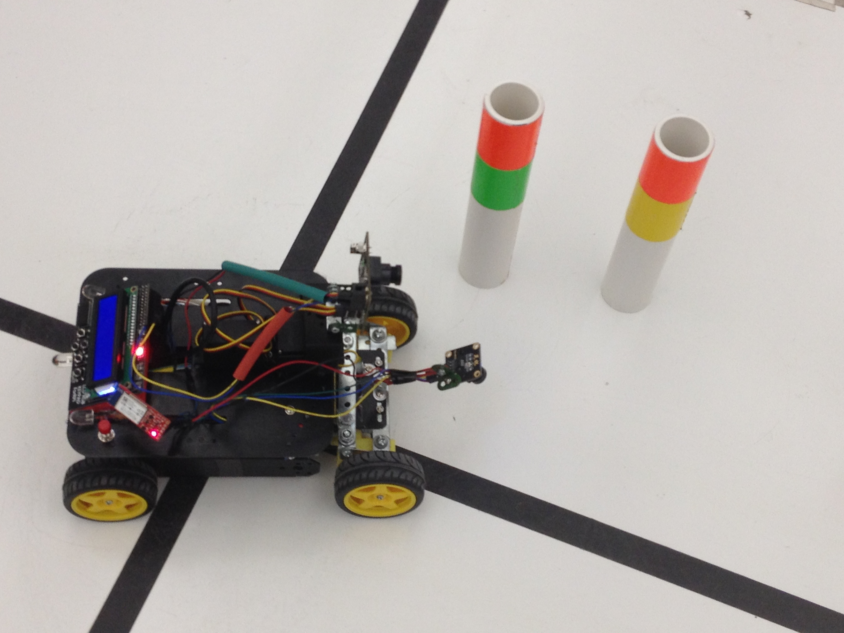
Car System Requirements
It must be able to follow the black line accurately
It must change its turning direction based on a marker color code
It must perform three operation modes (The user must be able to select any mode at any time)

Slide 4
Design Decomposition
The Following system components were design to satisfy each system requirement
A line tracker using a line camera with a TAOS Linear Sensor Array
A marker identifier using a CMUCam5 Pixy Vision Sensor Camera
A mechanical component implementing Front Steering
A Hybrid-PID controller
Additional Features used to improve user interaction

Slide 5
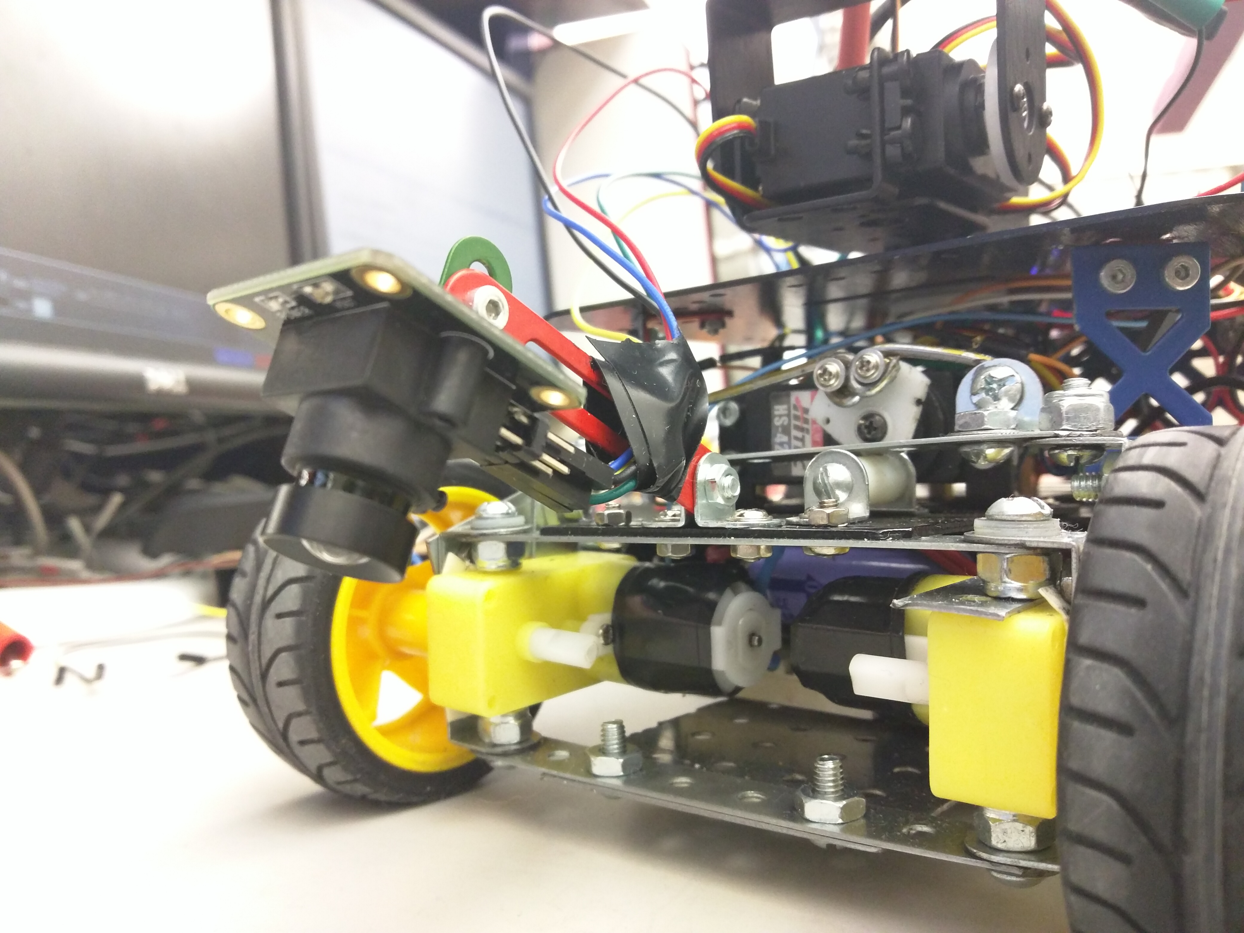
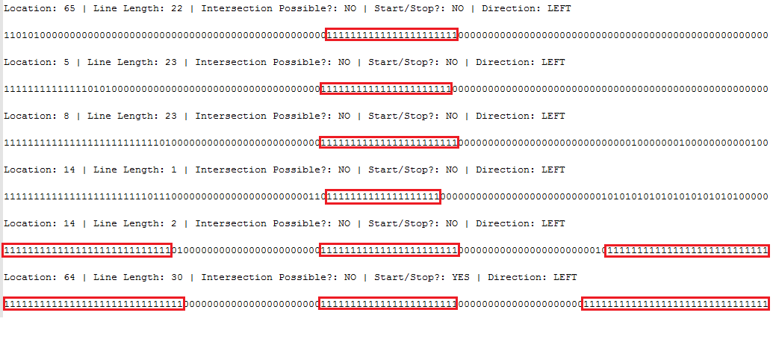
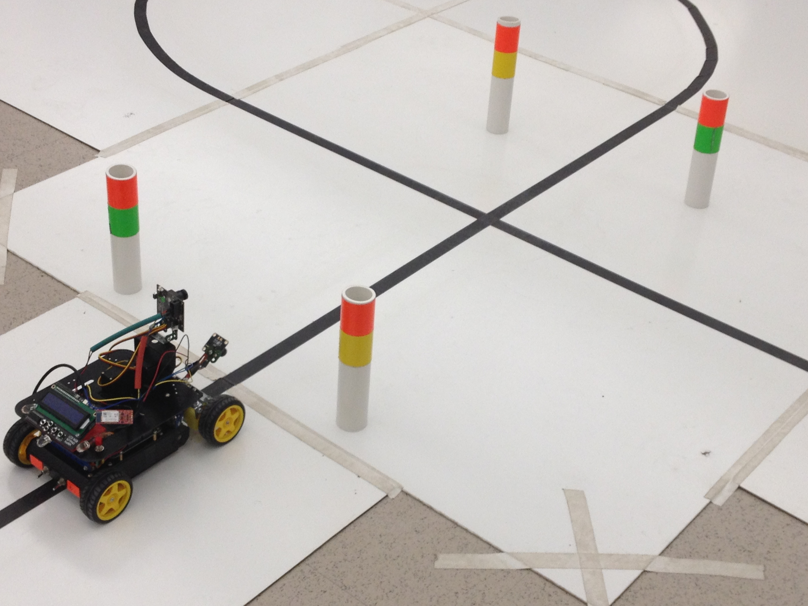
Line Camera w/ TAOS Linear Sensor Array
Line camera software capabilities:
Detect the position of the line with respect to the center of the car
Identify the Start/Stop line
Identify intersections
Discard noise and unreliable data

Slide 6
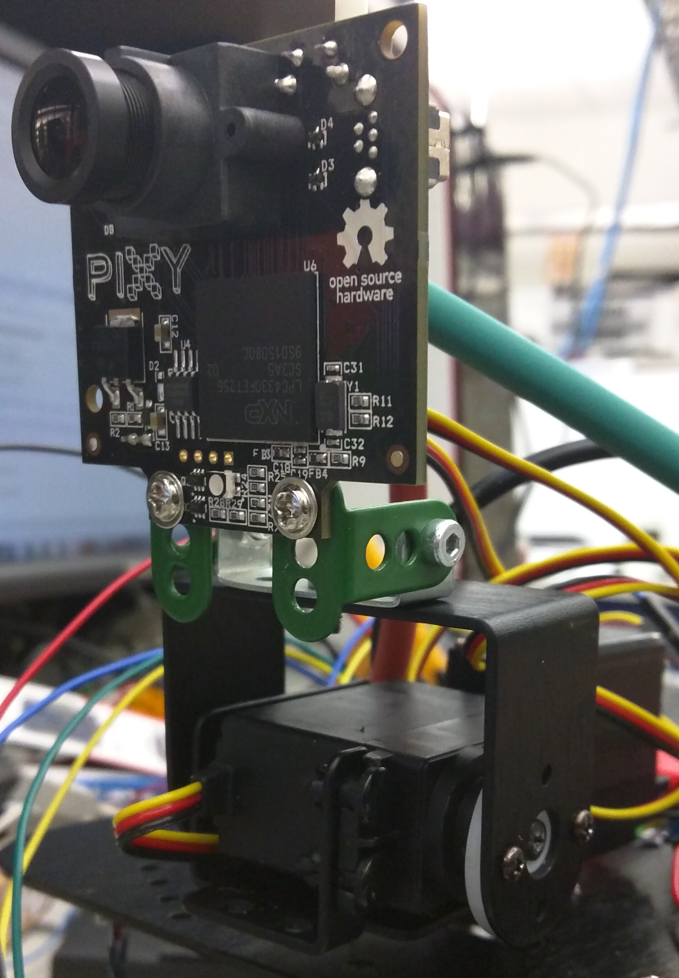
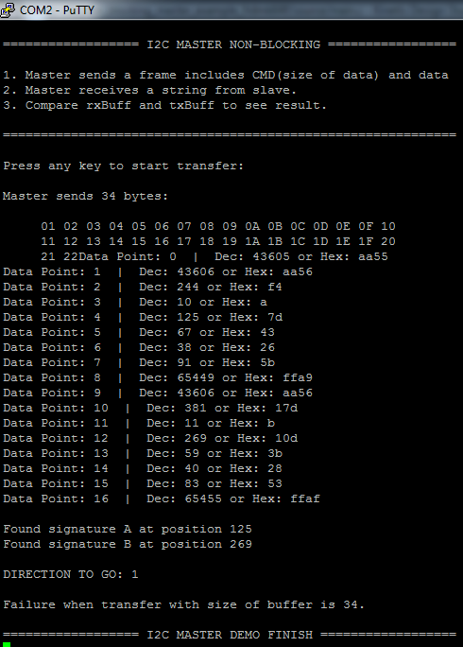
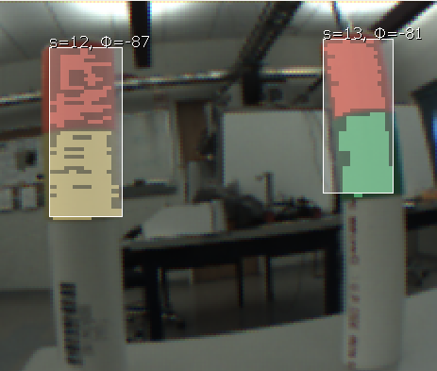
CMUCam5 Pixy Vision Sensor Camera
Detect and determine the signature of the color posts while ignoring posts past intersections.
Mounted on the car using pan-tilt mechanism used to maintain a reliable position.

Slide 7
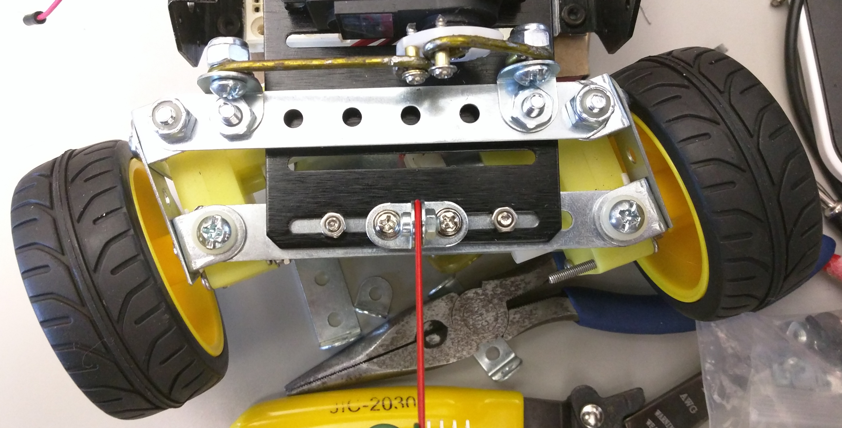
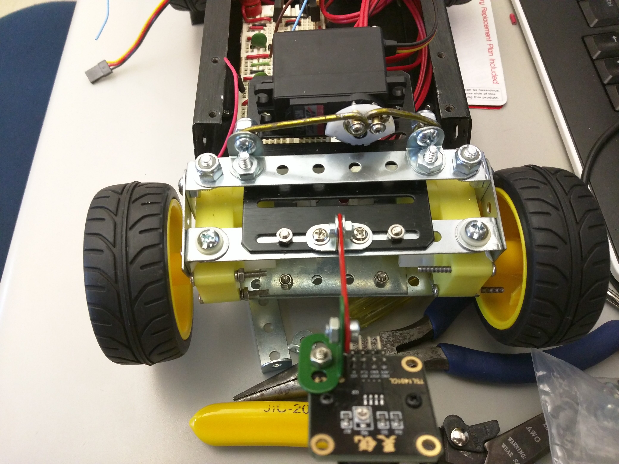
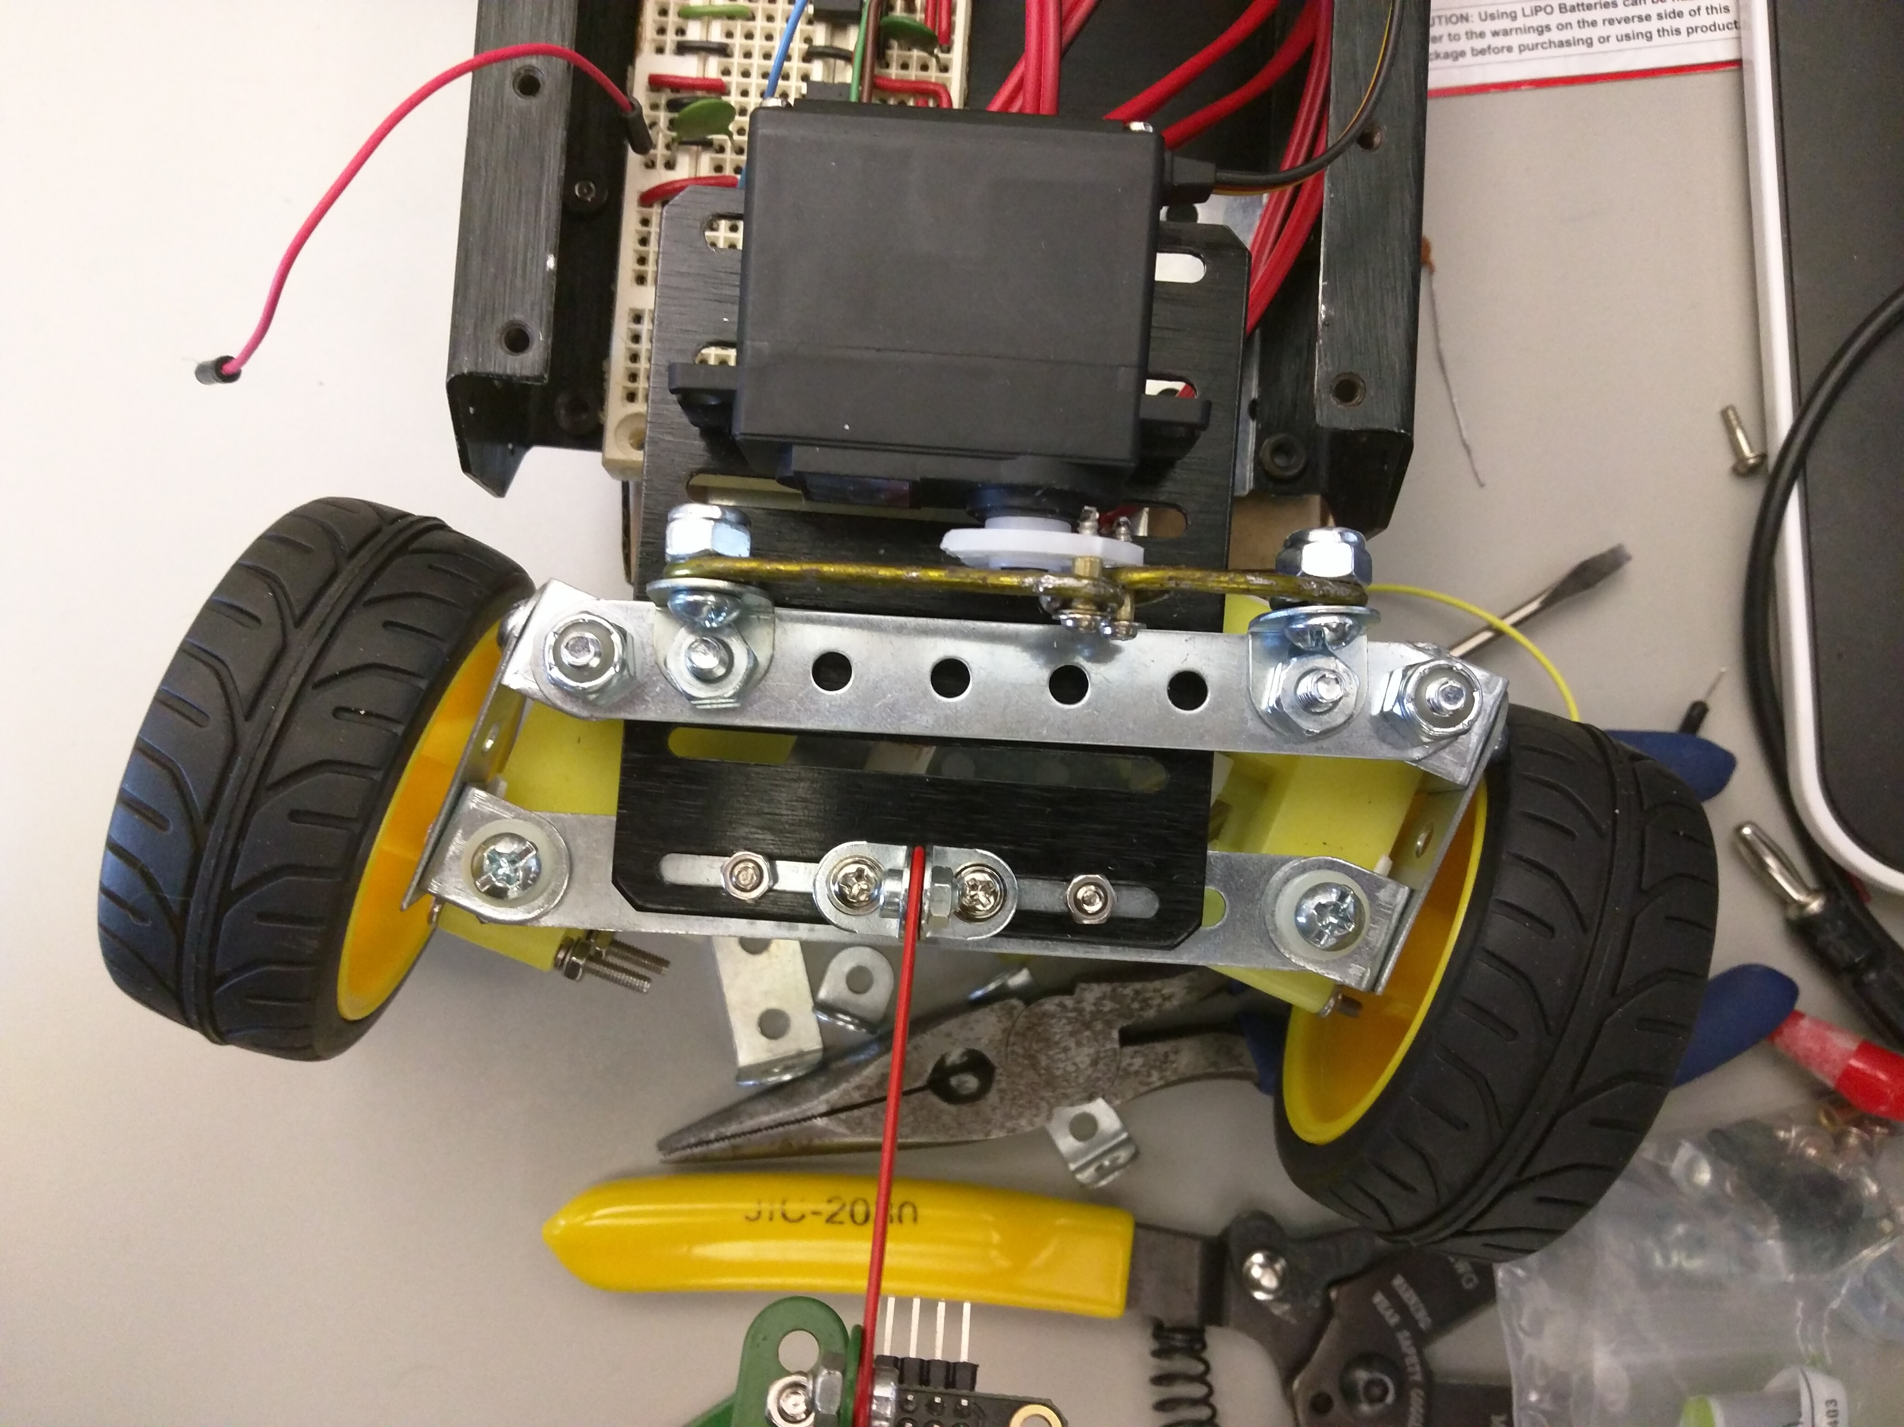
Front Steering
Front steering performance and advantages:
A servo can turn the front motors and wheel form 30 to -30 degrees
The car is able to perform smaller adjustments
The car is able to turn at faster speeds

Slide 8
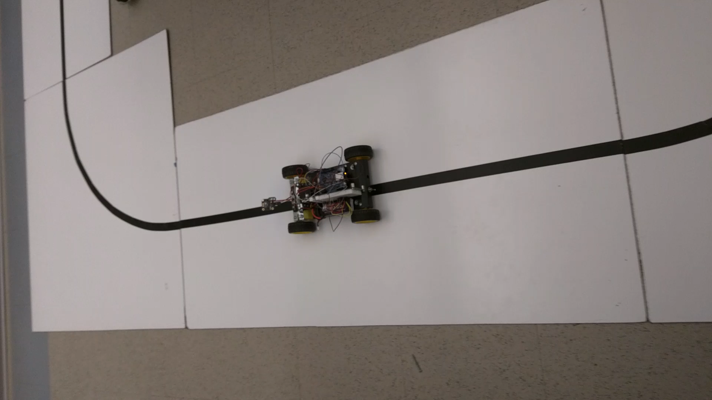
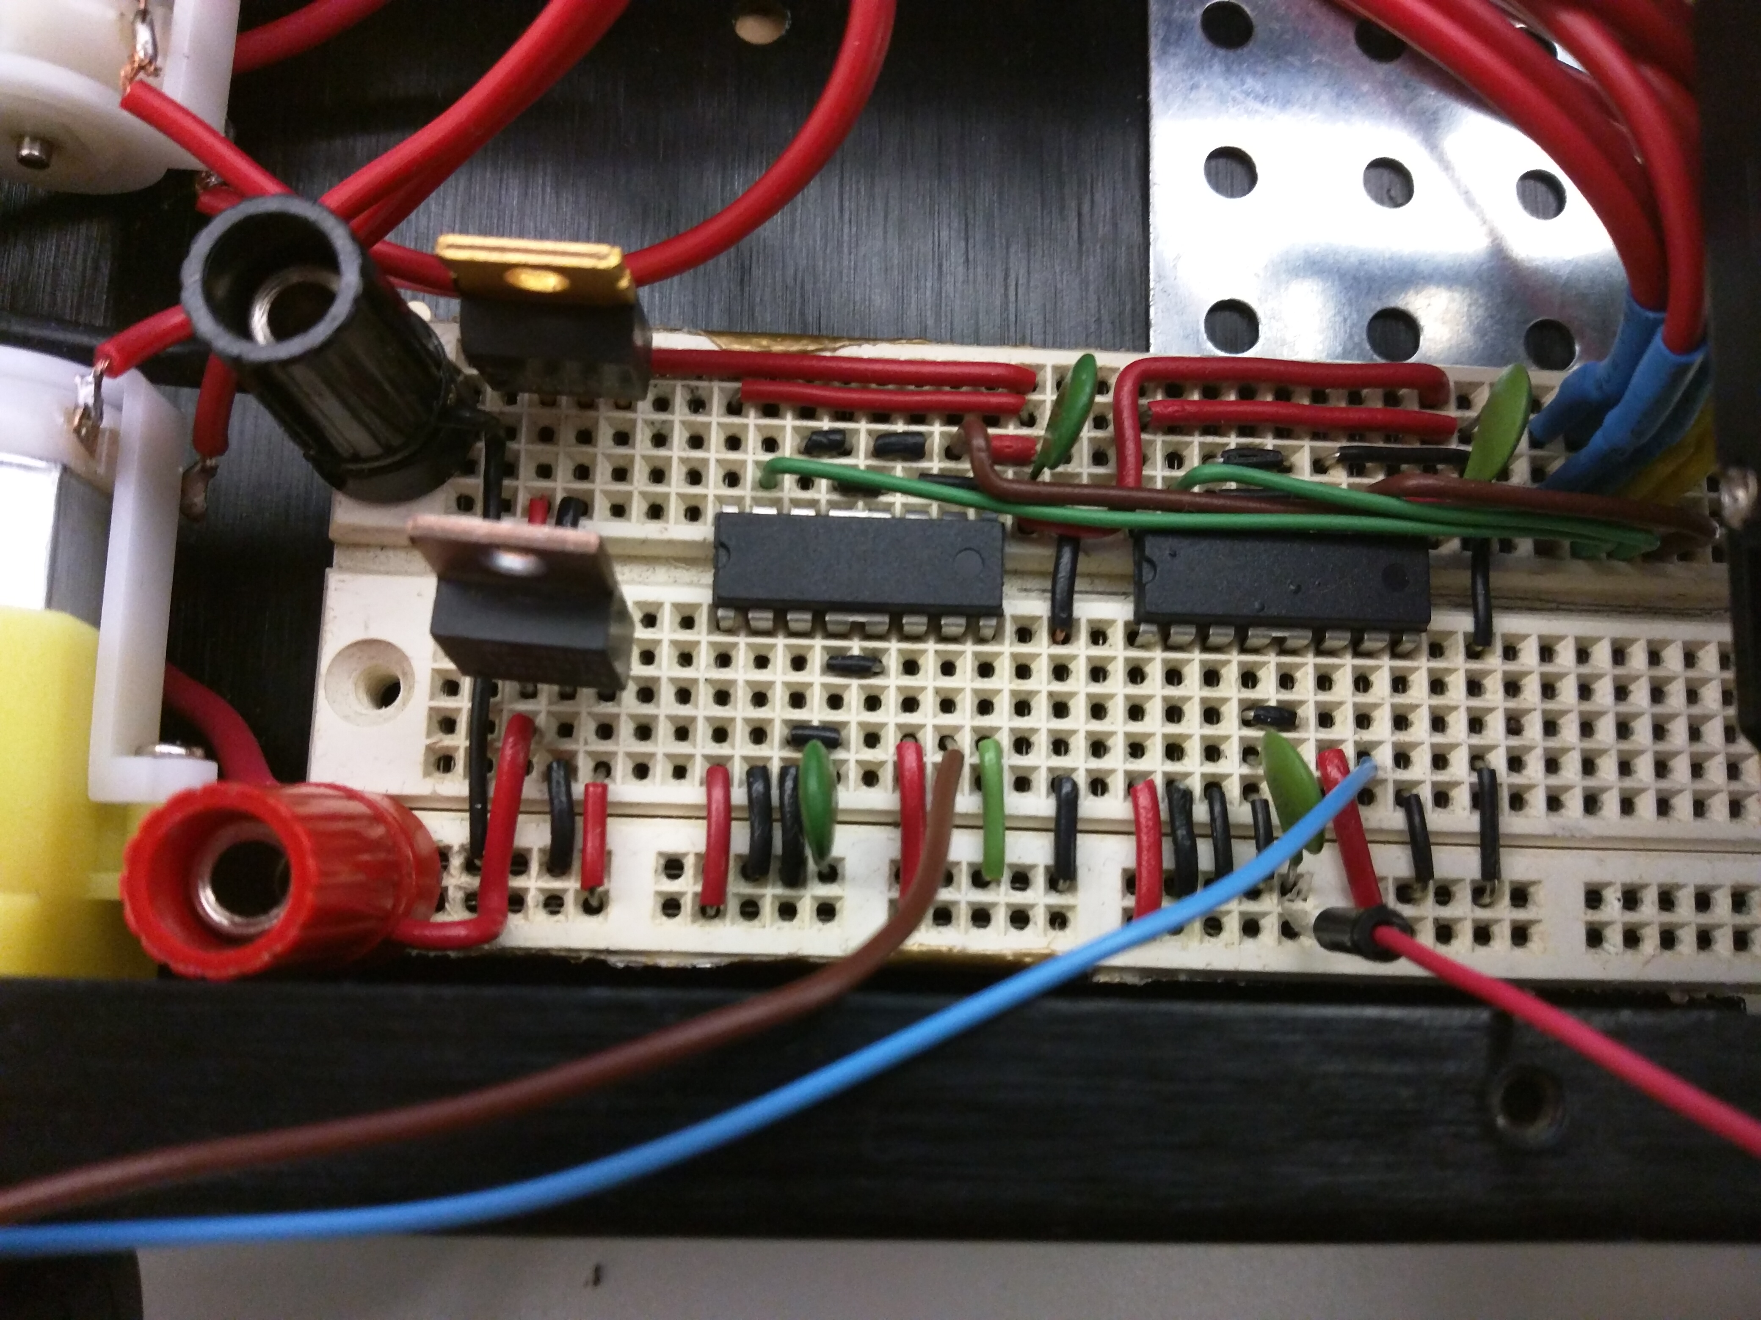
Hybrid-Pid controller
Implemented to compensate for under steering
Has 3 PIDs – one for steering and one for each side of the car.
Motor PIDs only activate when the steering is not enough.

Slide 9
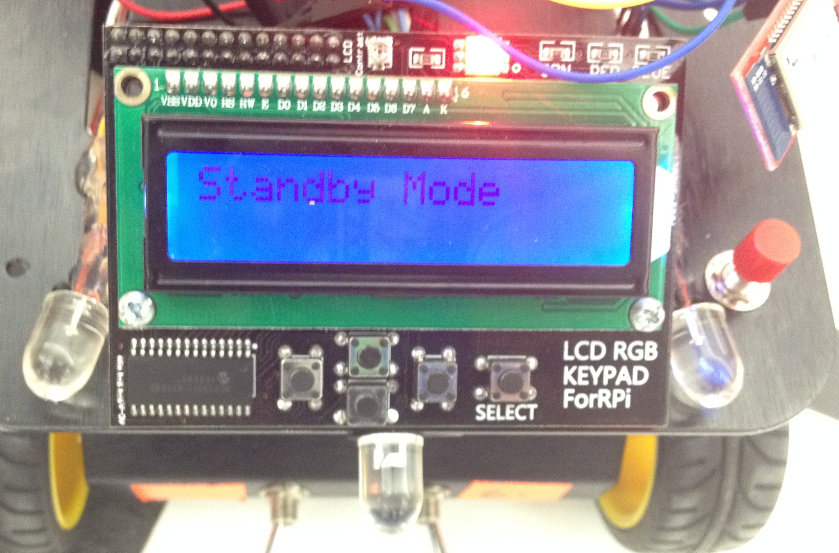
Additional Features
LCD
The different operation modes are displayed on al LCD panel,.
The user can select an operation mode using the button on the left (white) of the LCD and activate it using the one on the right (red)
Blinkers, Brake Light
When the Pixy camera recognizes a direction signature the LED corresponding to that direction will turn on
When the car is at the standby mode or if an intersection is recognized.

Slide 10
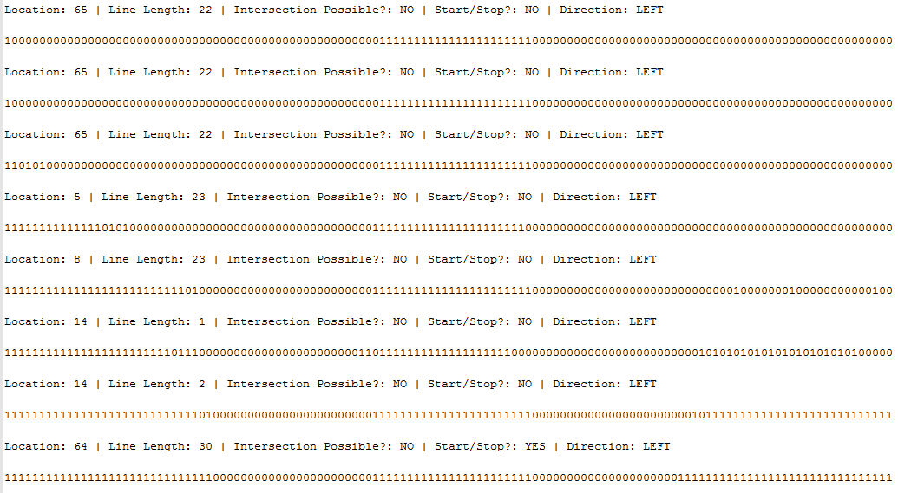
More Additional features
Data logging using SD-Card and Bluetooth

Slide 11
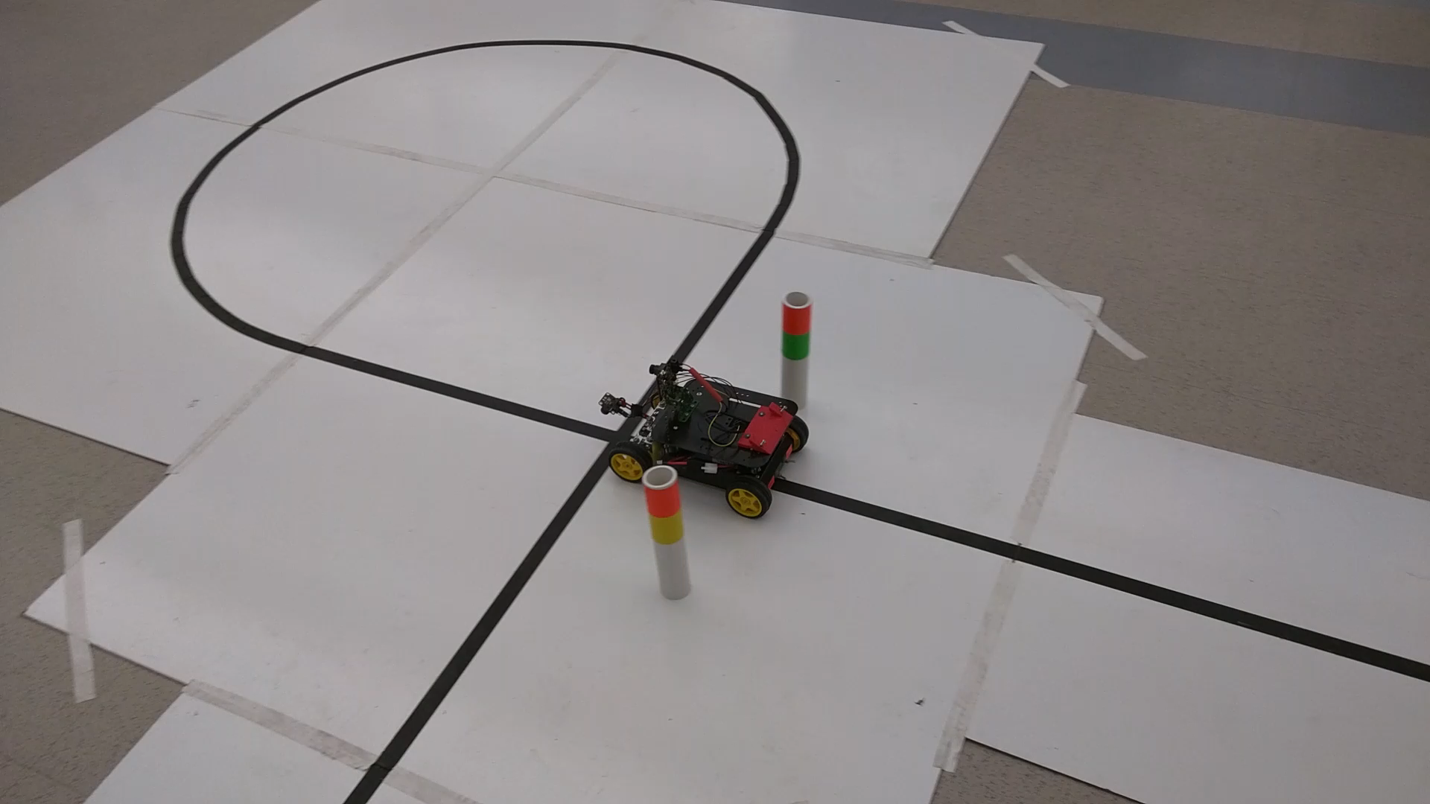
Video of basic functionality

Slide 12
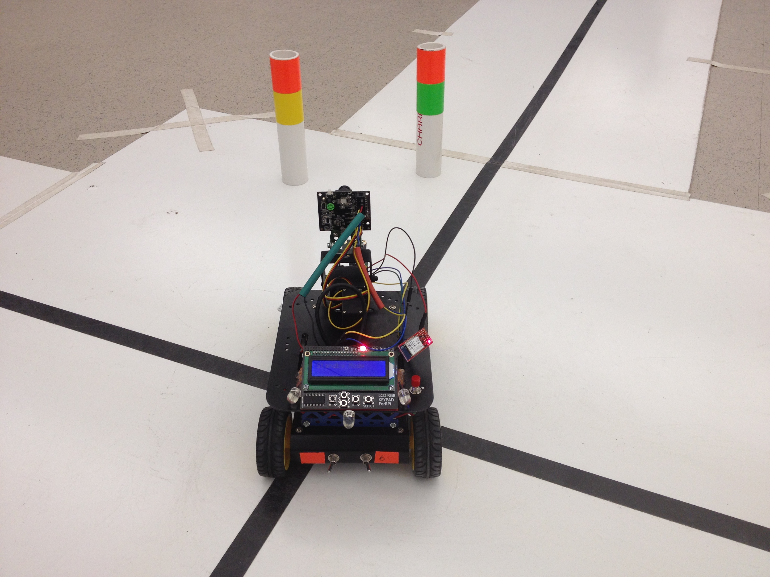
Unique Innovations
Our design uses a unique Hybrid driving controller. Utilizing a front steering system and a standard differential. By implementing both of this components the car is able to make sharper turns at higher speeds and turn on its on axis when an intersection is detected.

Slide 13
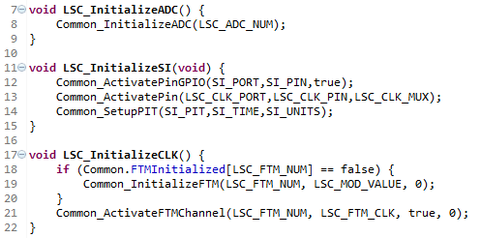
MORE Unique Innovations
Our software design is very modular and very easy to read.
A partial library was developed which acts similar to the HAL.
Multiple structs and typedefs allow us to mimic classes.

Slide 14
Design Weakness
Electromagnetic Interference
Under-steering
Physical switches sometimes cause the operation mode to change
Ambient light affects the detection of the intersection line or the start/stop line

Slide 15
Technology Assessment
Noise reduction and avoidance techniques learned here can benefit future projects that also involve noise.
If the project were a product for the public, such as a pacemaker, it could greatly benefit society.
Color code detection can be modified to help read road signs for autonomous cars.

Slide 16
Acknowledgements and References
Dr. Abul Khondker
CMUCam5 Pixy Vision Sensor Camera
K64 Sub-Family Reference Manual
Straight Outta CompE Design Documentation.

Slide 17

Questions?

